Slide 1
Airbox detection block-chain system
Nick HU

Slide 2
Proposal
Green food has been a common diary term. Food is the most important part of our lives. Making sure the food safety is also deeply important. Improving the safety of food may have huge cost. Therefore, the green food is much more likely to be more expensive. However, consumers can not easily distinguish the real green healthy food from the fake one. And what makes it worse is that some fake green food may mixed with the real one and it makes the consumers confused and damages the interest of real green food.

Slide 3
Solution
It is very important to detect which one is the green food and which one is not. As is known to most of us, the water is often a measure factor in our environment quality. What water is to the environment is like the blood to our body. Therefore if we can measure the quality of air, we can easily tell which one is the real green food.

Slide 4
Solution
So we can build a block-chain system to solve our problem. Block-chain is a kind of immutable data structure. It has accurate credit and the data are of great accuracy. The system will allow everyone to upload data into the block-chain and the data are open to everyone. By this way, we can build a Air Quality Field Detection Block-chain to measure the air quality to tell which is the real green food.

Slide 5
Sensor
The sensor in our system is the Airbox
By measuring some basic physical quantities
We can measure the quality of air.

Slide 6
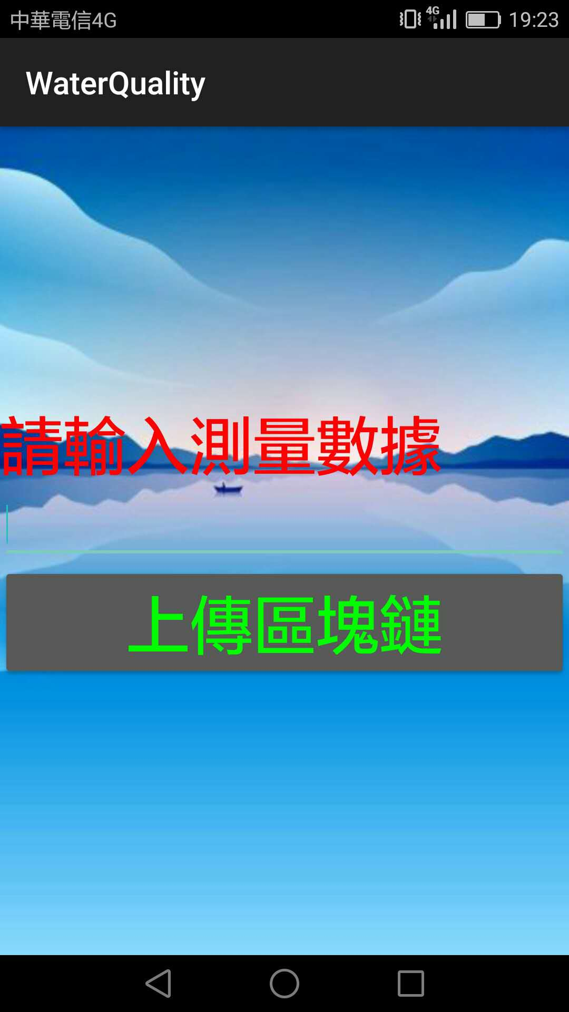
Upload data
We upload the data through android app and everyone is allowed to upload the data into the block-chain.
We can also upload data through sensor

Slide 7
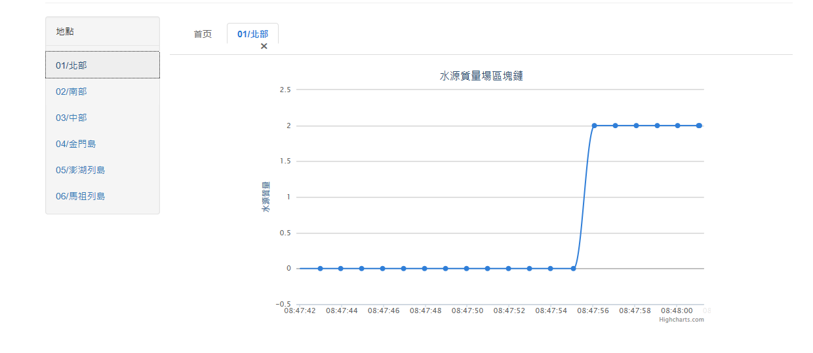
Sharing the data
After the data are uploaded, we can visit the website to get the data and the data are open to everyone.

Slide 8
The consensus between the data
The data is stored in the block-chain system, which is distributed to every node of the system.
The node can get consensus through voting.

Slide 9
Demo
The data can be visited through URL http://149.28.40.229/pro
The data can be uploaded through android apps.

Slide 10
Thanks for your listening！

